Slide 1
Induction and Recurrence Equations
CS 521 – Recitation 1
Week 2 – September 27

Slide 2
Induction
Induction and recursion are closely related
For a recursive algorithm, we need a base case and to define how to combine recursively solved subproblems together
For an inductive proof, we need a base case and an inductive step which uses the fact that the statement is true for a smaller instance to show that it remains true for a larger one
General structure for inductive proof of statement P(n) for all integers n >= n₀:
Show that P(n₀) is true – Base Case
Assume that P(n) is true for all n <= k – Inductive Hypothesis
Use the inductive hypothesis to show that P(k+1) is true – Inductive Step

Slide 3
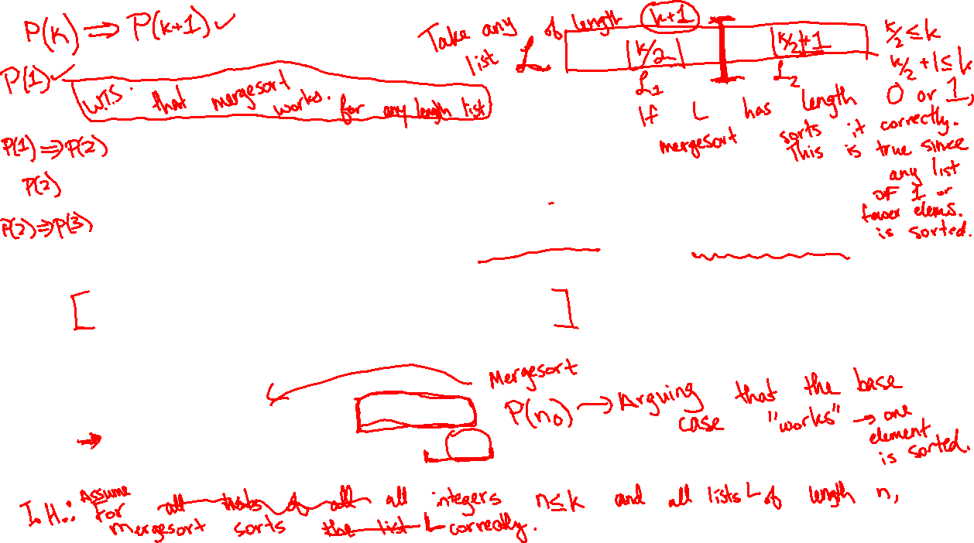
Induction
Induction and recursion are closely related
For a recursive algorithm, we need a base case and to define how to combine recursively solved subproblems together
For an inductive proof, we need a base case and an inductive step which uses the fact that the statement is true for a smaller instance to show that it remains true for a larger one
General structure for inductive proof of statement P(n) for all integers n >= n₀:
Show that P(n₀) is true – Base Case
Assume that P(n) is true for all n <= k – Inductive Hypothesis
Use the inductive hypothesis to show that P(k+1) is true – Inductive Step

Slide 4
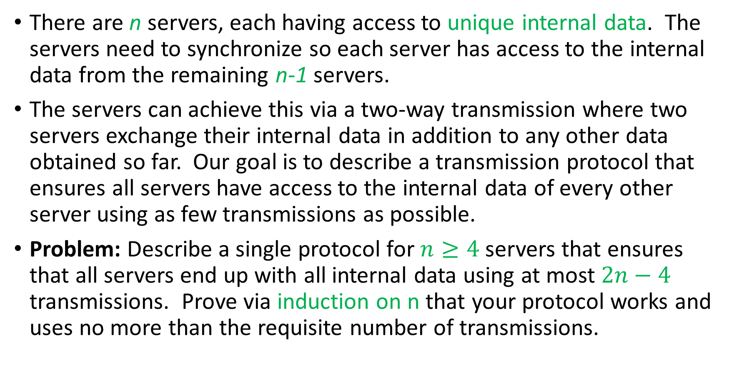
Induction Problem: Server Synchronization
There are n servers, each having access to unique internal data. The servers need to synchronize so each server has access to the internal data from the remaining n-1 servers.
The servers can achieve this via a two-way transmission where two servers exchange their internal data in addition to any other data obtained so far. Our goal is to describe a transmission protocol that ensures all servers have access to the internal data of every other server using as few transmissions as possible.
Problem: Describe a single protocol for $n≥4$ servers that ensures that all servers end up with all internal data using at most $2n−4$ transmissions. Prove via induction on n that your protocol works and uses no more than the requisite number of transmissions.

Slide 5

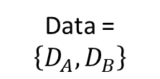
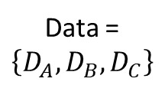
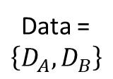
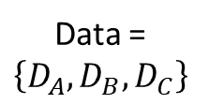

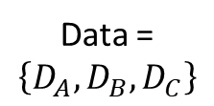

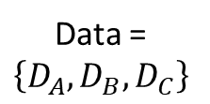
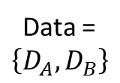


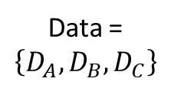
Server synchronization
Server A
Server B
Server C
Server A
Server B
Server C
Data = $\left\{D_{A}\right\}$
Data = $\left\{D_{B}\right\}$
Data = $\left\{D_{C}\right\}$
Data = $\left\{D_{A}, D_{B}\right\}$
Data = $\left\{D_{A},D_{B}\right\}$
Data = $\left\{D_{C}\right\}$
Server A
Server B
Server C
Server A
Server B
Server C
Data = $\left\{D_{A}, D_{B}\right\}$
Data = $\left\{D_{A},D_{B},D_{C}\right\}$
Data =
$$\left\{D_{A},D_{B},D_{C}\right\}$$
Data = $\left\{D_{A}, D_{B},D_{C}\right\}$
Data = $\left\{D_{A},D_{B},D_{C}\right\}$
Data =
$$\left\{D_{A},D_{B},D_{C}\right\}$$

Slide 6
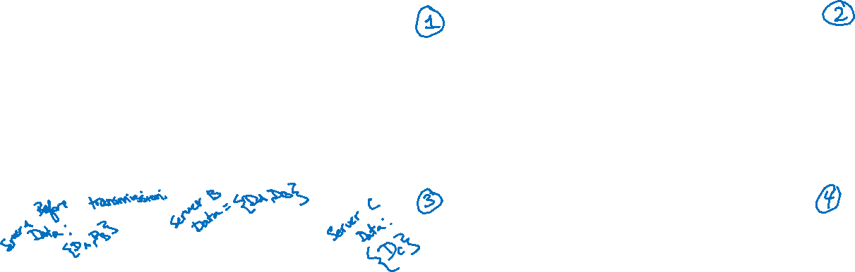
Server synchronization
Server A
Server B
Server C
Server A
Server B
Server C
Data = $\left\{D_{A}\right\}$
Data = $\left\{D_{B}\right\}$
Data = $\left\{D_{C}\right\}$
Data = $\left\{D_{A}, D_{B}\right\}$
Data = $\left\{D_{A},D_{B}\right\}$
Data = $\left\{D_{C}\right\}$
Server A
Server B
Server C
Server A
Server B
Server C
Data = $\left\{D_{A}, D_{B}\right\}$
Data = $\left\{D_{A},D_{B},D_{C}\right\}$
Data =
$$\left\{D_{A},D_{B},D_{C}\right\}$$
Data = $\left\{D_{A}, D_{B},D_{C}\right\}$
Data = $\left\{D_{A},D_{B},D_{C}\right\}$
Data =
$$\left\{D_{A},D_{B},D_{C}\right\}$$

Slide 7

Induction Problem: Server Synchronization
There are n servers, each having access to unique internal data. The servers need to synchronize so each server has access to the internal data from the remaining n-1 servers.
The servers can achieve this via a two-way transmission where two servers exchange their internal data in addition to any other data obtained so far. Our goal is to describe a transmission protocol that ensures all servers have access to the internal data of every other server using as few transmissions as possible.
Problem: Describe a single protocol for $n≥4$ servers that ensures that all servers end up with all internal data using at most $2n−4$ transmissions. Prove via induction on n that your protocol works and uses no more than the requisite number of transmissions.

Slide 8
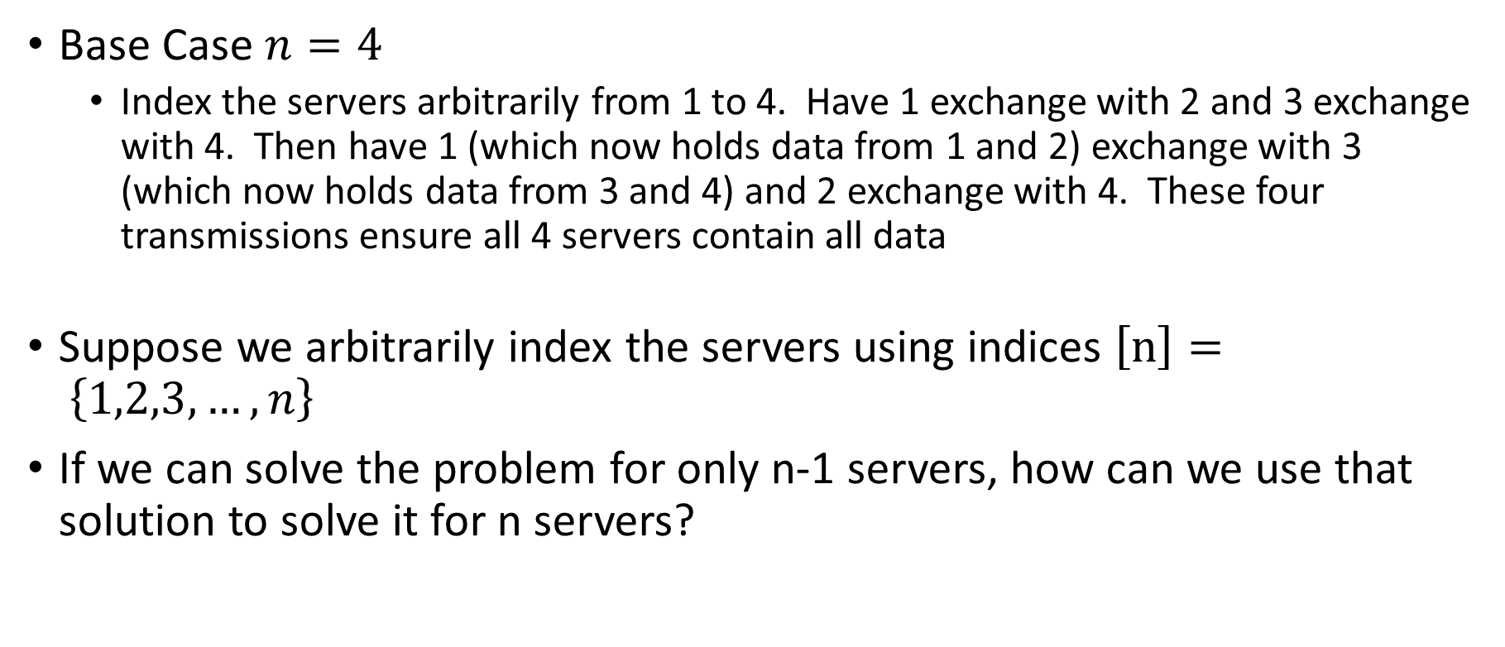
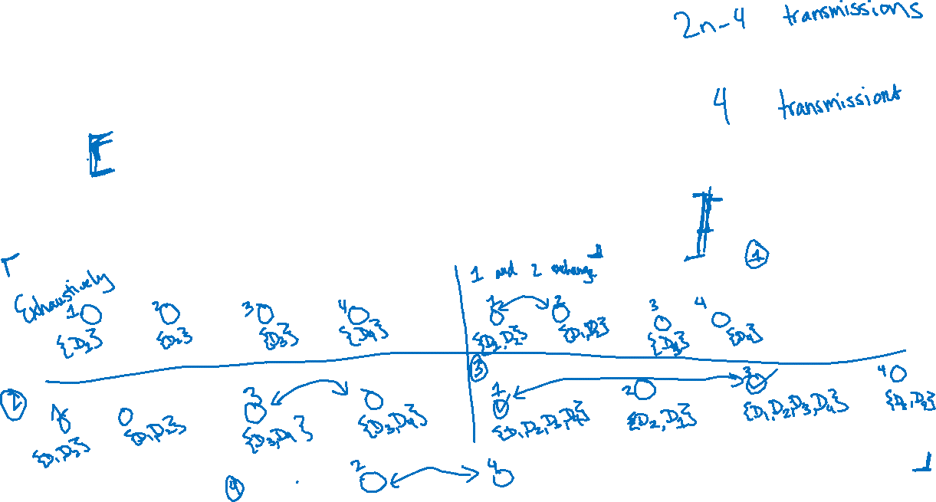
Designing our recursive protocol
Base Case $n=4$
Index the servers arbitrarily from 1 to 4. Have 1 exchange with 2 and 3 exchange with 4. Then have 1 (which now holds data from 1 and 2) exchange with 3 (which now holds data from 3 and 4) and 2 exchange with 4. These four transmissions ensure all 4 servers contain all data
Suppose we arbitrarily index the servers using indices $\left[n\right]= \left\{1,2,3,…,n\right\}$
If we can solve the problem for only n-1 servers, how can we use that solution to solve it for n servers?

Slide 9
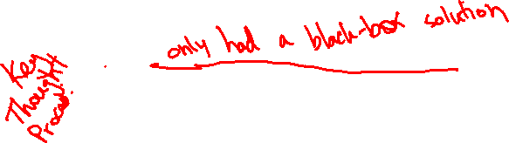
Designing our recursive protocol
Base Case $n=4$
Index the servers arbitrarily from 1 to 4. Have 1 exchange with 2 and 3 exchange with 4. Then have 1 (which now holds data from 1 and 2) exchange with 3 (which now holds data from 3 and 4) and 2 exchange with 4. These four transmissions ensure all 4 servers contain all data
Suppose we arbitrarily index the servers using indices $\left[n\right]= \left\{1,2,3,…,n\right\}$
If we can solve the problem for only n-1 servers, how can we use that solution to solve it for n servers?

Slide 10


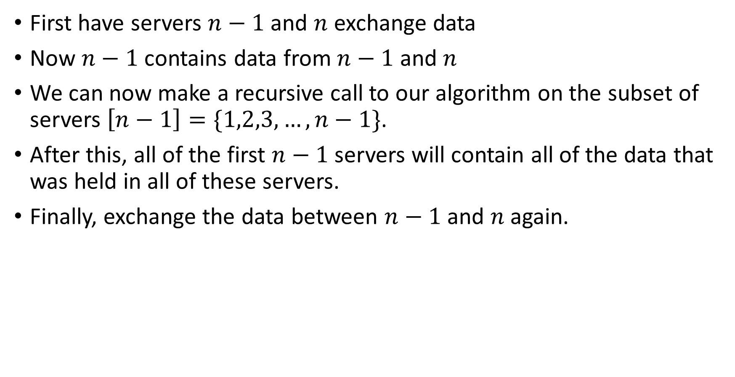
Designing our protocol – The recursive step
First have servers $n−1$ and $n$ exchange data
Now $n−1$ contains data from $n−1$ and $n$
We can now make a recursive call to our algorithm on the subset of servers $\left[n−1\right]=\{1,2,3,…,n−1\}$.
After this, all of the first $n−1$ servers will contain all of the data that was held in all of these servers.
Finally, exchange the data between $n−1$ and $n$again.
Recursive Call

Slide 11
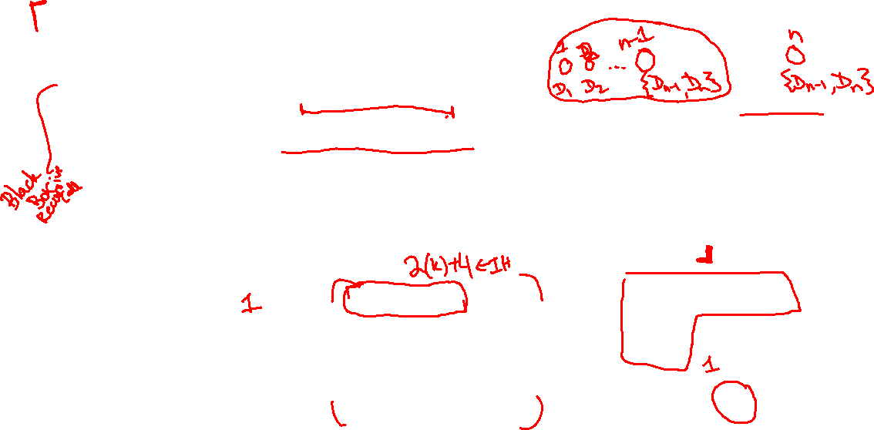
Designing our protocol – The recursive step
First have servers $n−1$ and $n$ exchange data
Now $n−1$ contains data from $n−1$ and $n$
We can now make a recursive call to our algorithm on the subset of servers $\left[n−1\right]=\{1,2,3,…,n−1\}$.
After this, all of the first $n−1$ servers will contain all of the data that was held in all of these servers.
Finally, exchange the data between $n−1$ and $n$again.
Recursive Call

Slide 12
Base Case – n = 4
By observation, the four transmissions we describe for servers 1,2,3,4 suffice to ensure that all servers have all the data.
1 <-> 2, 3 <-> 4, 1 <-> 3, 2 <-> 4
We also note that 4 = 2(4) – 4, so we also satisfy the base case for the requisite maximum number of transfers.

Slide 13
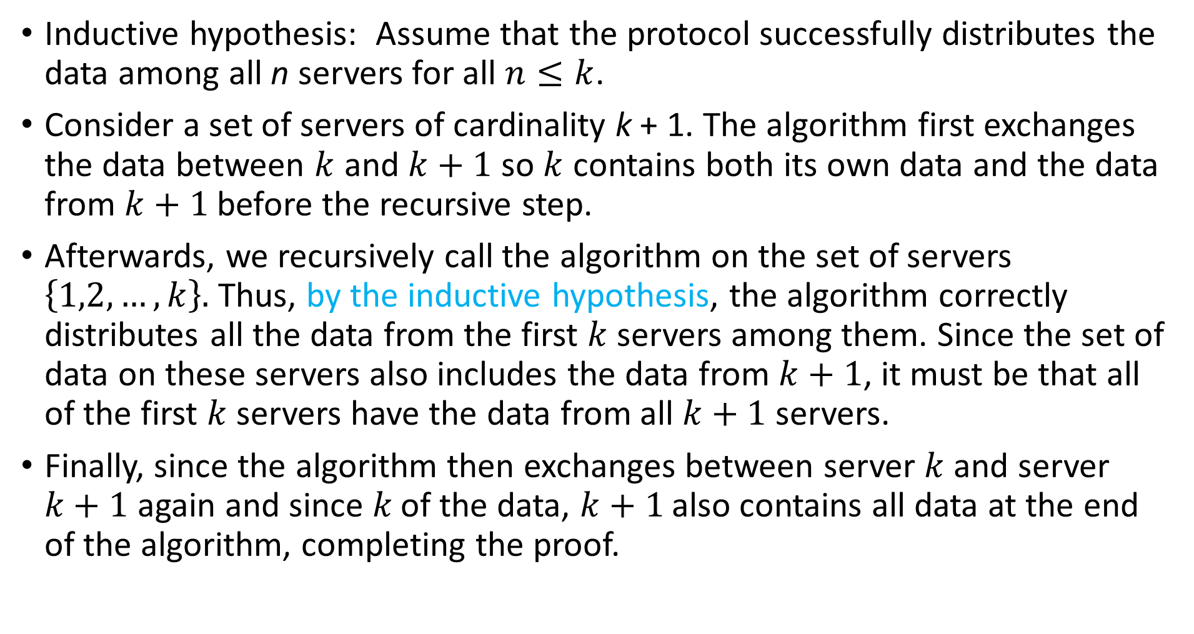
Inductive Step – Algorithm Correctness
Inductive hypothesis: Assume that the protocol successfully distributes the data among all n servers for all $n≤k$.
Consider a set of servers of cardinality k + 1. The algorithm first exchanges the data between $k$ and $k+1$ so $k$ contains both its own data and the data from $k+1$before the recursive step.
Afterwards, we recursively call the algorithm on the set of servers $\left\{1,2,…,k\right\}.$ Thus, by the inductive hypothesis, the algorithm correctly distributes all the data from the first $k$ servers among them. Since the set of data on these servers also includes the data from $k+1$, it must be that all of the first $k$ servers have the data from all $k+1$ servers.
Finally, since the algorithm then exchanges between server $k$ and server $k+1$ again and since $k$ of the data, $k+1$ also contains all data at the end of the algorithm, completing the proof.

Slide 14
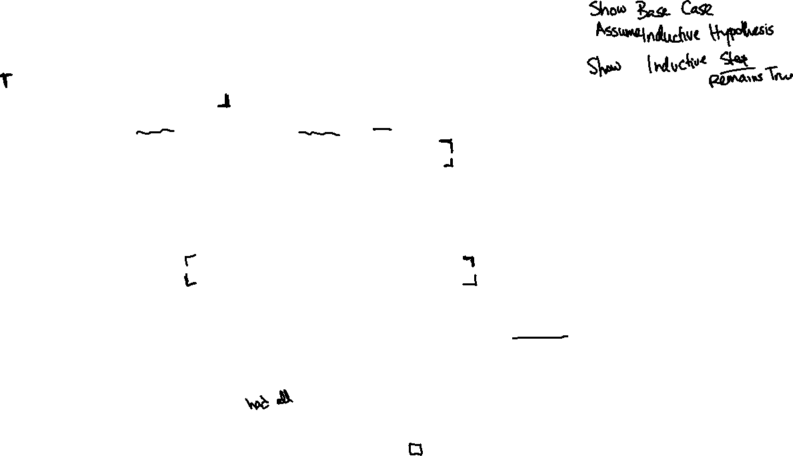
Inductive Step – Algorithm Correctness
Inductive hypothesis: Assume that the protocol successfully distributes the data among all n servers for all $n≤k$.
Consider a set of servers of cardinality k + 1. The algorithm first exchanges the data between $k$ and $k+1$ so $k$ contains both its own data and the data from $k+1$before the recursive step.
Afterwards, we recursively call the algorithm on the set of servers $\left\{1,2,…,k\right\}.$ Thus, by the inductive hypothesis, the algorithm correctly distributes all the data from the first $k$ servers among them. Since the set of data on these servers also includes the data from $k+1$, it must be that all of the first $k$ servers have the data from all $k+1$ servers.
Finally, since the algorithm then exchanges between server $k$ and server $k+1$ again and since $k$ of the data, $k+1$ also contains all data at the end of the algorithm, completing the proof.

Slide 15
Inductive Step – Number of Queries
Inductive hypothesis: Assume that the protocol uses only 2n - 4 queries for all n <= k.
Assume that there are k + 1 servers. We know that the protocol makes one transmission before making its recursive call and one additional transmission at the end.
By the inductive hypothesis, the protocol uses at most 2k – 4 queries in its recursive call. But then, in total, it uses at most 2k - 4 + 2 = 2k - 2 = 2(k+1) – 4 queries in total, the desired bound.

Slide 16
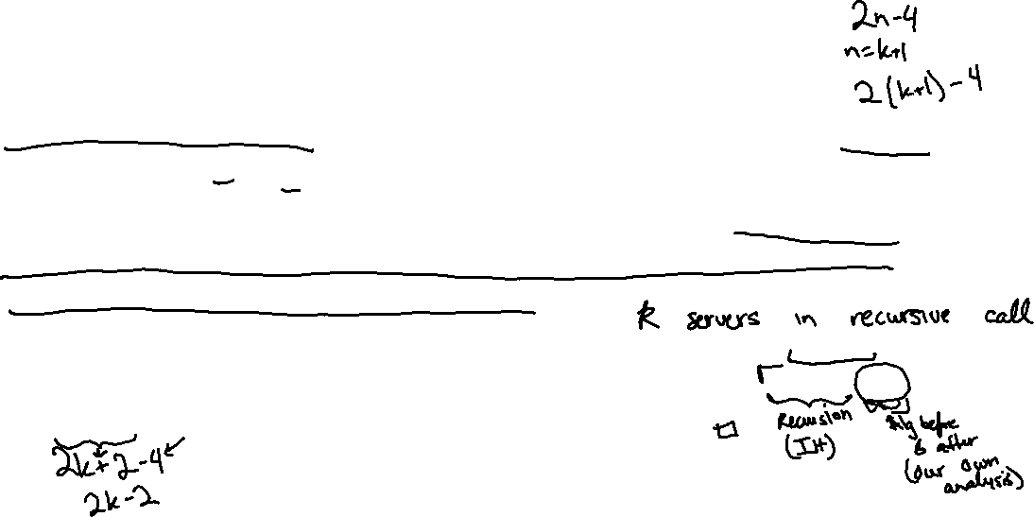
Inductive Step – Number of Queries
Inductive hypothesis: Assume that the protocol uses only 2n - 4 queries for all n <= k.
Assume that there are k + 1 servers. We know that the protocol makes one transmission before making its recursive call and one additional transmission at the end.
By the inductive hypothesis, the protocol uses at most 2k – 4 queries in its recursive call. But then, in total, it uses at most 2k - 4 + 2 = 2k - 2 = 2(k+1) – 4 queries in total, the desired bound.

Slide 17
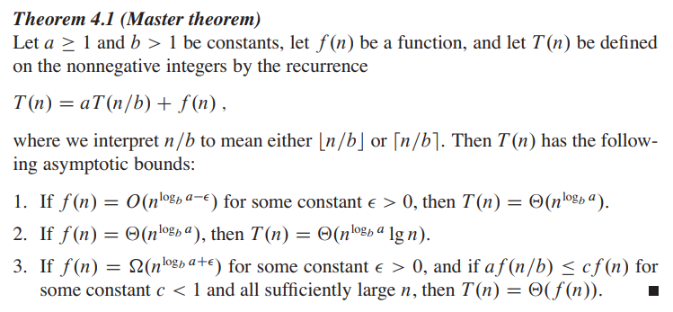
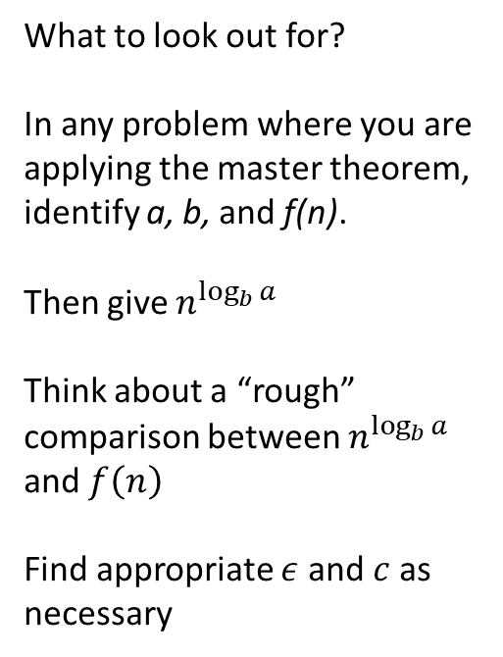
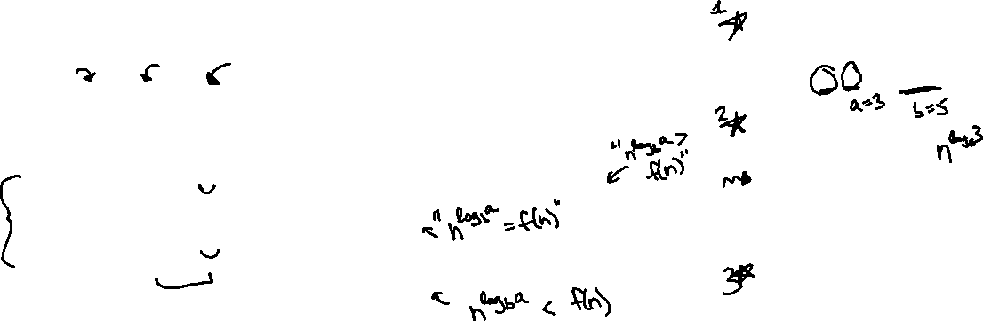
The master theorem
What to look out for?
In any problem where you are applying the master theorem, identify a, b, and f(n).
Then give $n^{\log_{b}{a}}$
Think about a “rough” comparison between $n^{\log_{b}{a}}$ and $f\left(n\right)$
Find appropriate $ε$ and $c$ as necessary

Slide 18

$$T\left(n\right)=2T\left(\frac{n}{2}\right)+8n$$

Slide 19
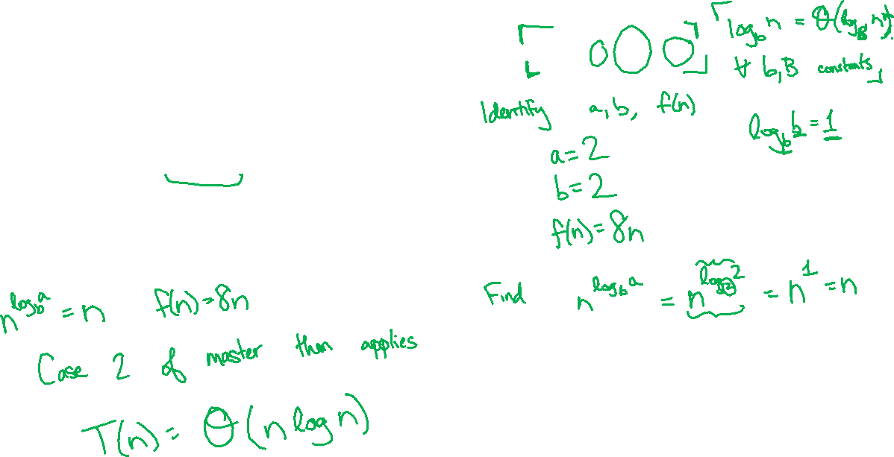
$$T\left(n\right)=2T\left(\frac{n}{2}\right)+8n$$

Slide 20

$$T\left(n\right)=3T\left(\frac{n}{2}\right)+n\log{n}$$

Slide 21
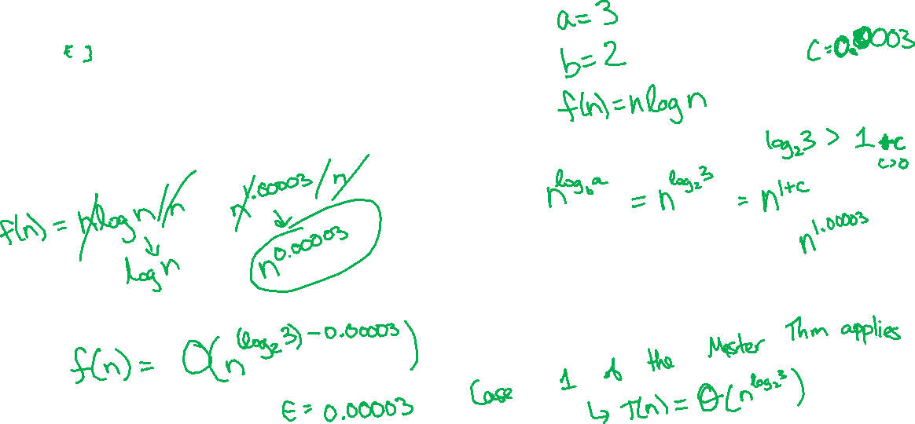
$$T\left(n\right)=3T\left(\frac{n}{2}\right)+n\log{n}$$

Slide 22

$$T\left(n\right)=3T\left(\frac{n}{2}\right)+{2n}^{2}$$

Slide 23
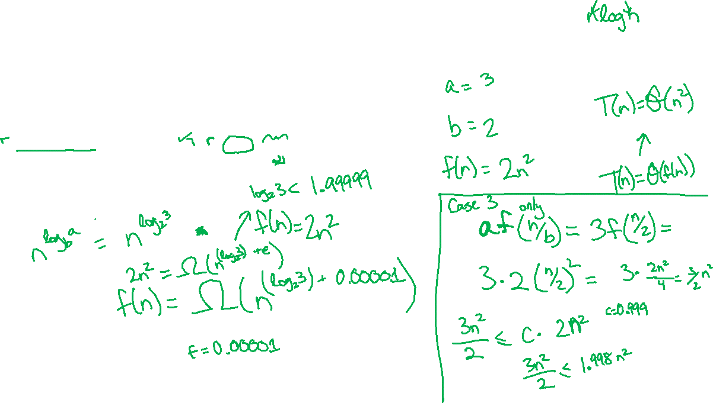
$$T\left(n\right)=3T\left(\frac{n}{2}\right)+{2n}^{2}$$

Slide 24

$$T\left(n\right)=4T\left(\frac{n}{2}\right)+{16n}^{2}+5n$$

Slide 25
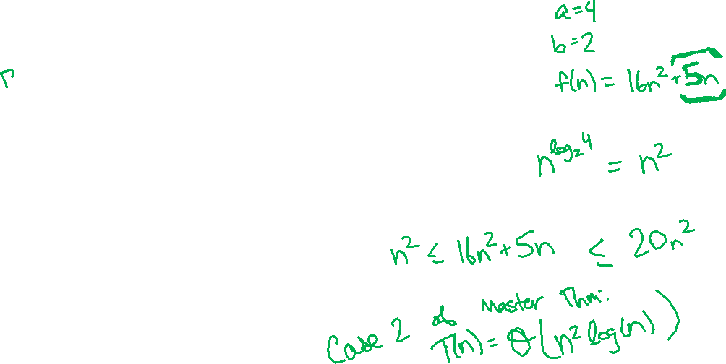
$$T\left(n\right)=4T\left(\frac{n}{2}\right)+{16n}^{2}+5n$$

Slide 26
$$T\left(n\right)=2T\left(n−1\right)+1$$

Slide 27
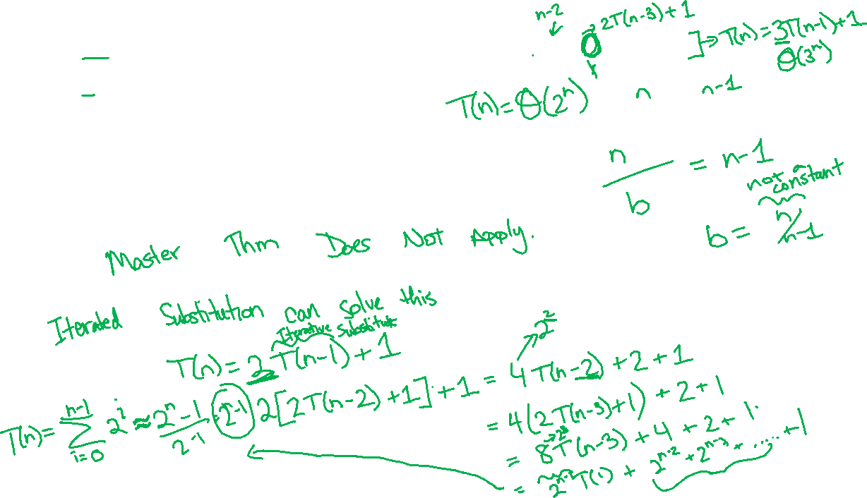
$$T\left(n\right)=2T\left(n−1\right)+1$$

